Slide 2
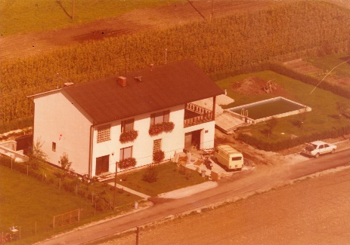
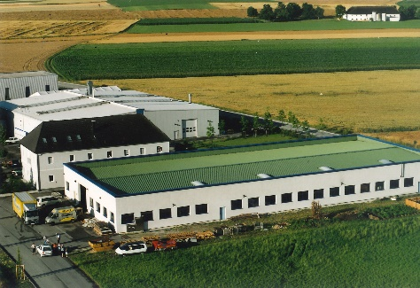
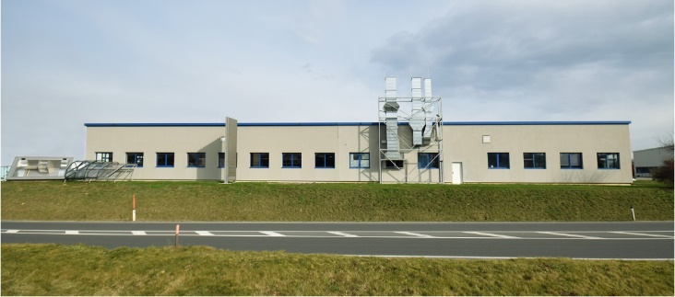


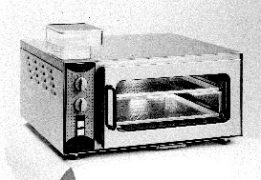
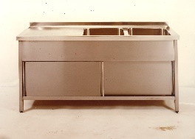
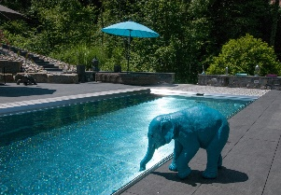
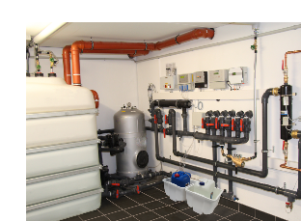

founded
by Johann & Hilde Gassner
1970
new factory at the current location 1995
extension of Hall #2 2005
Management Wolfgang Gassner 2010
acquisition
by .
2022
tinsmith- & locksmith work
facilities & ovens
start contract manufacturing - Swarco
1999
end production of oven
2020
continuous development in the field
of pool & contract manufacturing
first
stainless steel pool 1998
start of installing
water treatment systems 2004

Slide 3
OVERVIEW
Interesting and diversified combination of different areas, which makes us more flexible and much less dependent on seasonal fluctuations.

Slide 4
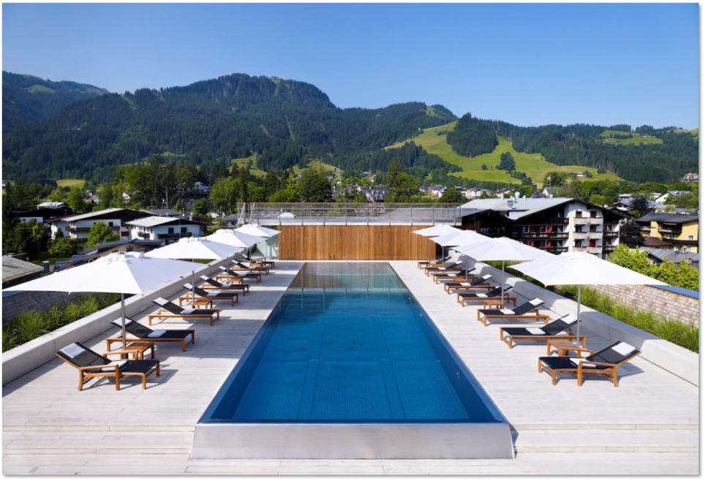
WHY
?
Technical details- USP

Slide 5
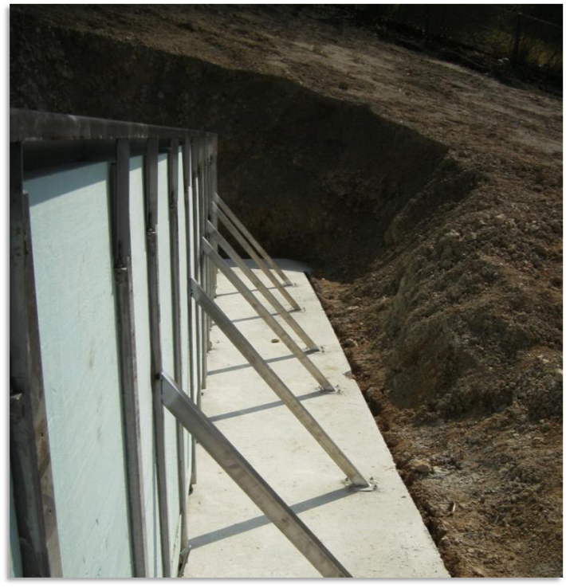
pool installation
- self carrying construction
☑️
☑️
☑️
no retaining walls and thus no breakthroughs (interfaces) for built-in parts
self-supporting construction on a base plate that is one meter larger all around
basin fully insulated with 6 cm (standard) - floor and walls

Slide 6
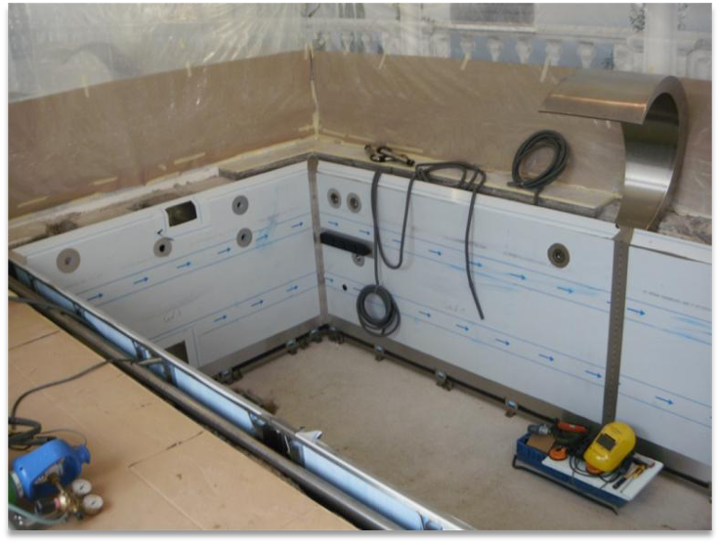
pool installation
- lining a concrete tub
☑️
☑️
☑️
static stiffening of the walls in spite of the concrete tank, but the load is then taken off the wall.
insulation sits directly on the basin and is glued, hardly any condensate is formed
particularly beautiful evenness of the side walls due to this method of construction

Slide 7
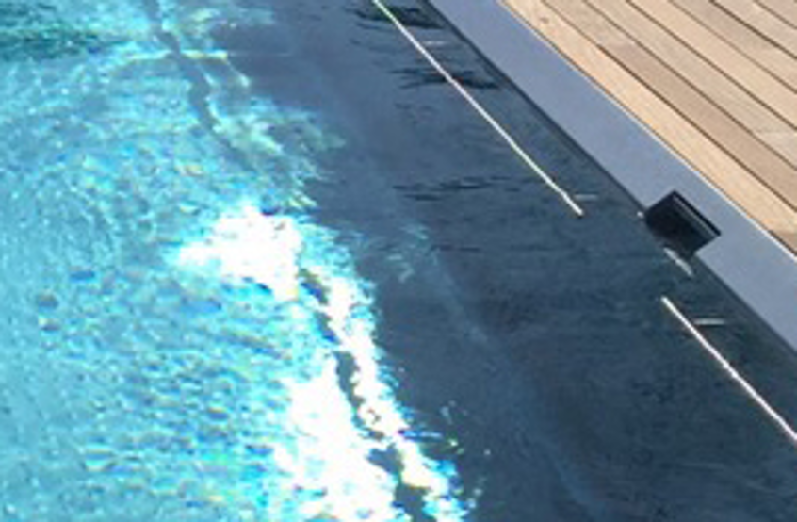
skimmer pool
☑️
☑️
☑️
☑️
no built-in skimmer (therefore fixed welded and permanently tight)
unique high water level of approx. 5 cm (waterline to top edge)
Skimmer top edge minus 35 mm - depending on pool head and floor covering
skimmer basket removable from water side
skimmer with width 235 mm or 400 mm

Slide 8
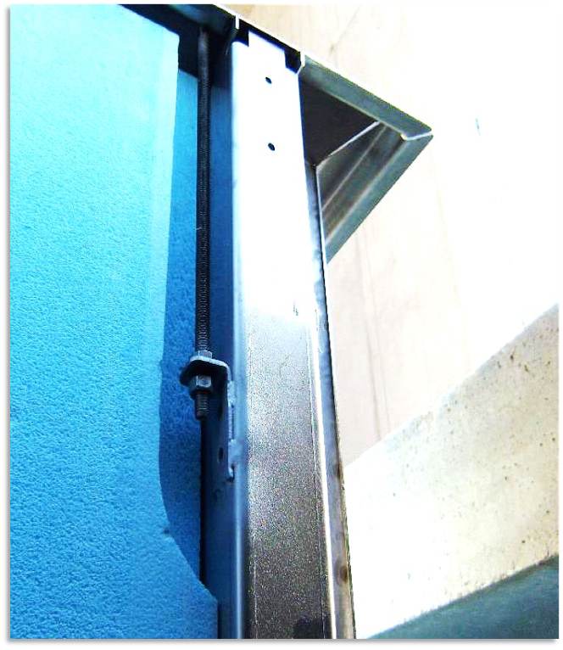
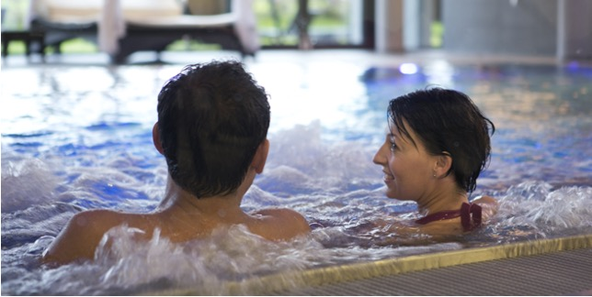
overflow basin
☑️
☑️
☑️
specially developed adjustment system of the overflow edge by means of stainless steel threaded rods (approx. every 50 - 60 cm).
a regular overflow on all sides is the requirement for pools like this.
for overflow basins, a level protocol from an external land surveyors is included for end customers.

Slide 9
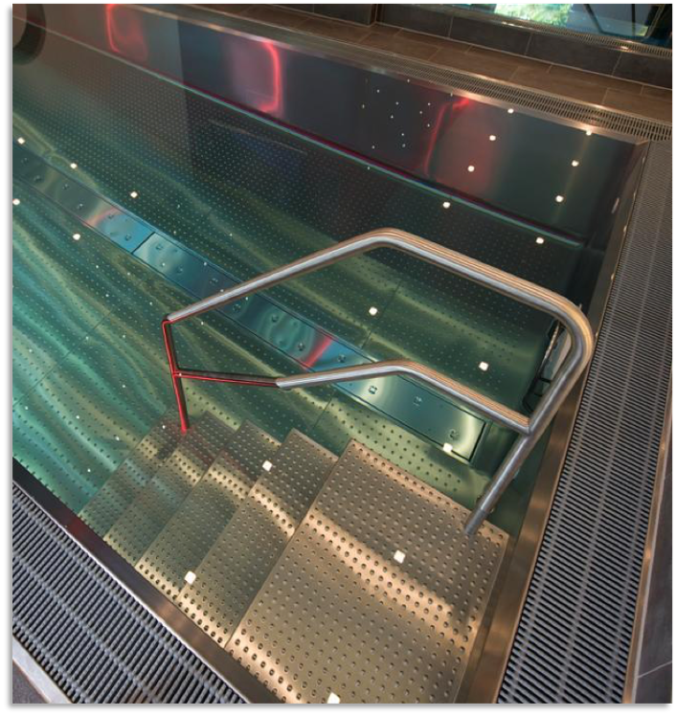
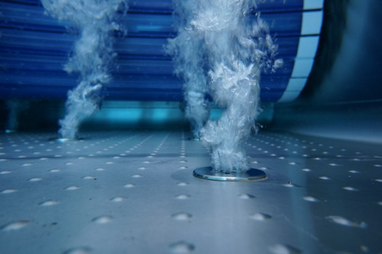
burling
☑️
☑️
☑️
☑️
burling the pool floor is adjusted to the shape of the pool.
the result is to have always the same distance to walls and stairs
all floor elements are burled (standard) - more beautiful appearance, smaller scratches and floor welds are lost
burls admit the standard and ensure optimal anti-slide-safety

Slide 10
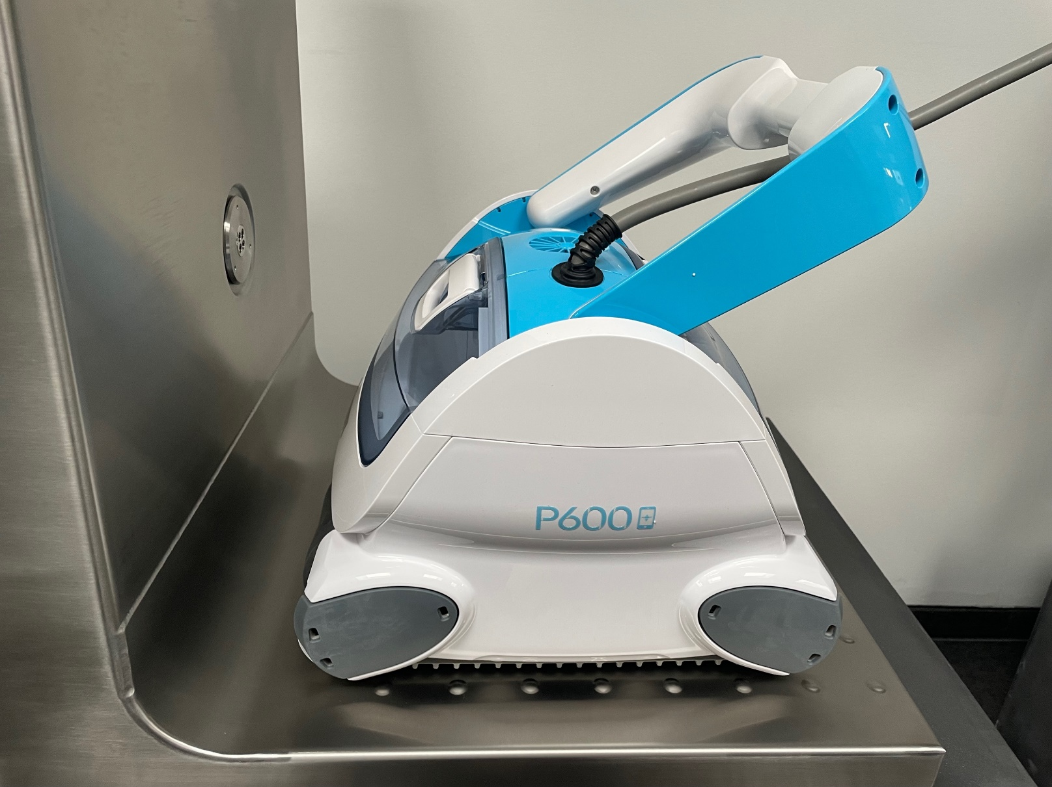
round
transition
☑️
☑️
The round transition between wall and floor makes it nearly impossible that dirt or debris stay.
100% cleaning of the transition is supported through the smaller distance to the edge for your pool robot.

Slide 11
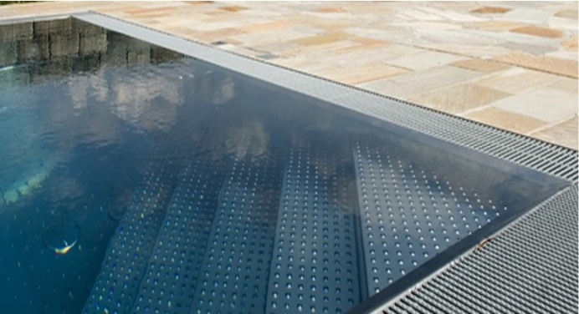
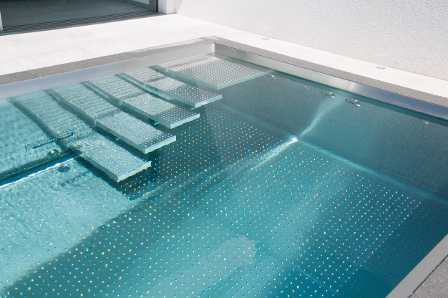
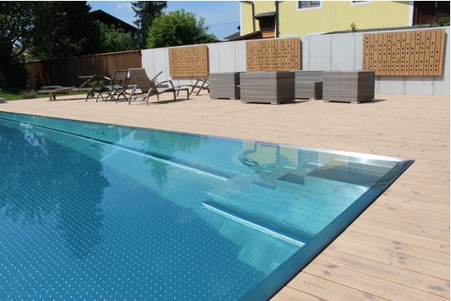
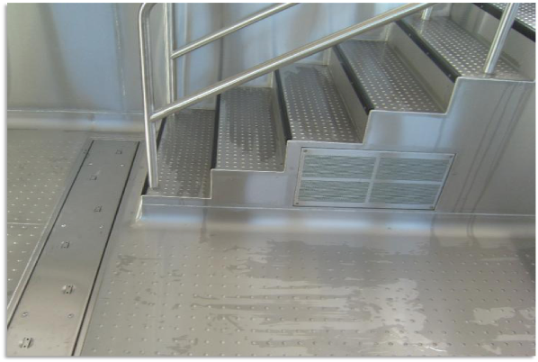
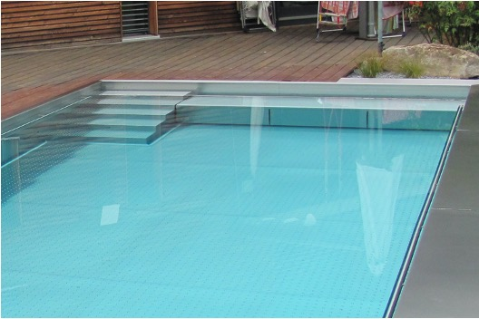
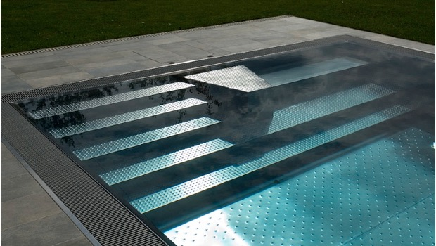
examples for stairs
corner stairs
self-carrying stairs (max. width 60 cm)
☑️
☑️
flexible and individual
possible in combination as
pool-cover niche
stairs straight with pedestal
public stairs (with step marking and handrail)
stairs and bench (as pool-cover niche)
custom made stairs (for countercurrent unit)

Slide 12
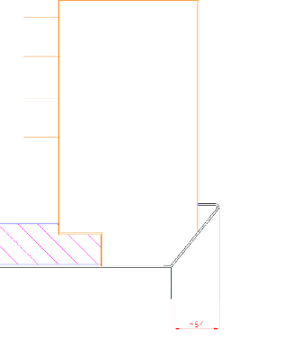
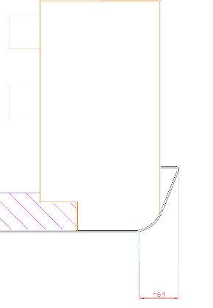
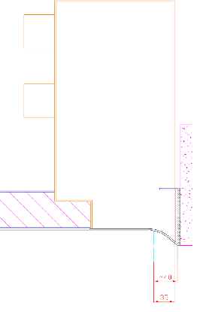
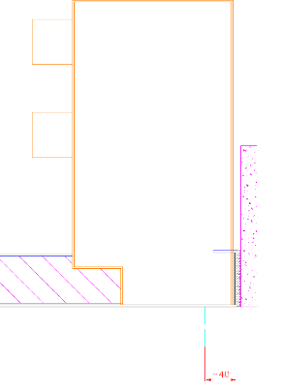
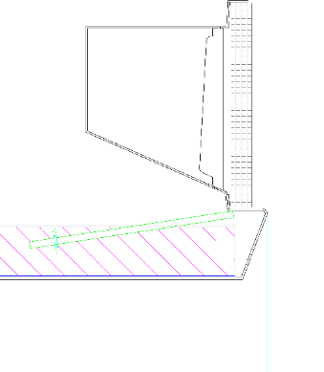
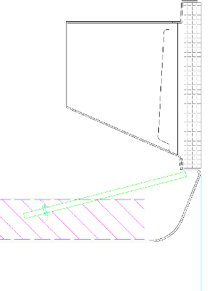
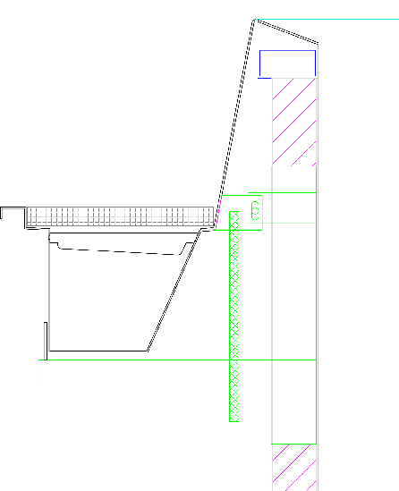
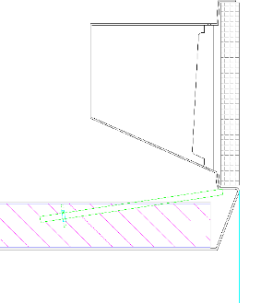
pool „head“
skimmerpool
☑️
☑️
individual - even with skimmer!!!
flexible connection to the adjacent floor
slant
round
wave reflection
straight
overflow basin
slant
slant with
grip edge
round
infinity

Slide 13
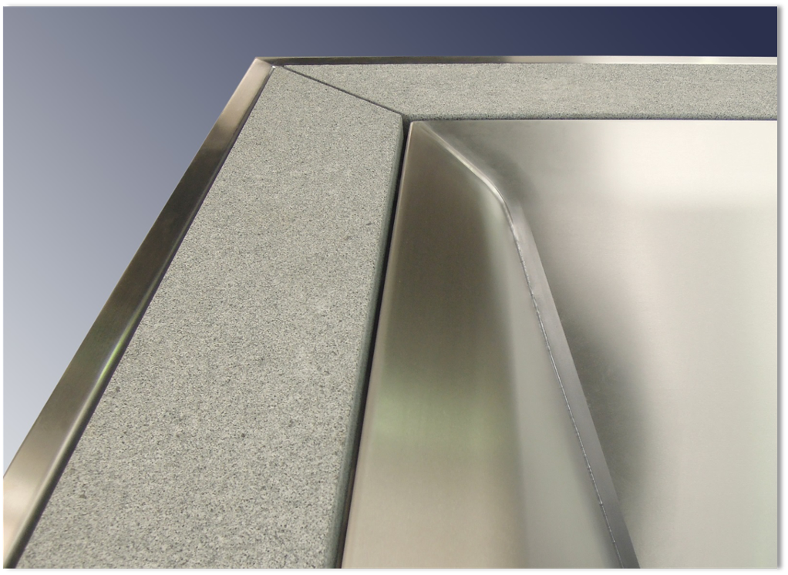
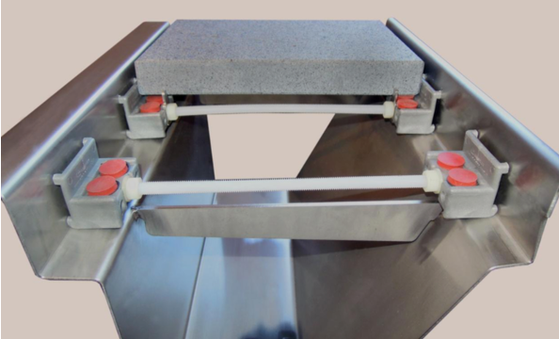
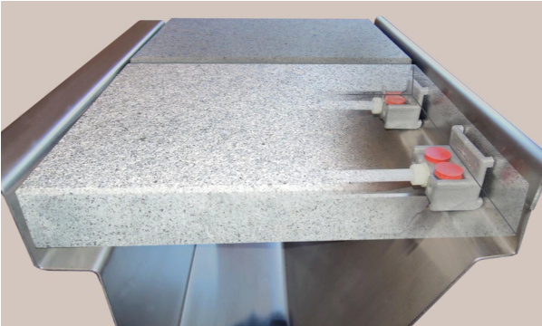
overflow channel with stone cover
☑️
☑️
☑️
☑️
flexible and individual
only minimal point contact with the stainless steel
easily removable for cleaning the channel
spacer for constant, even spacing

Slide 14
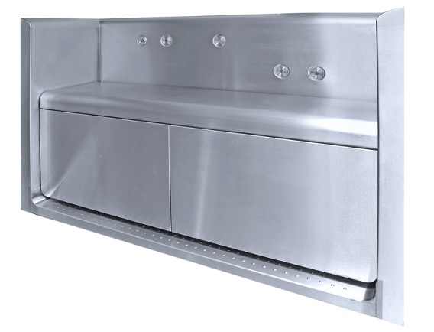
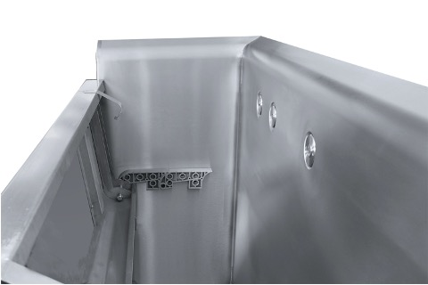
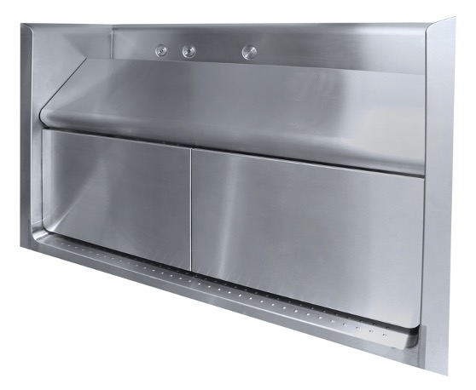
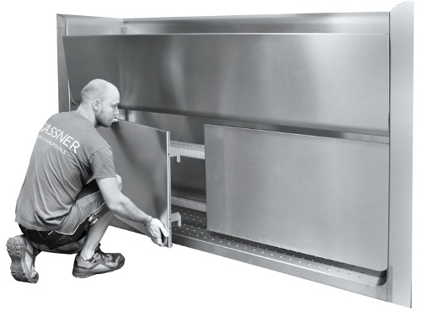
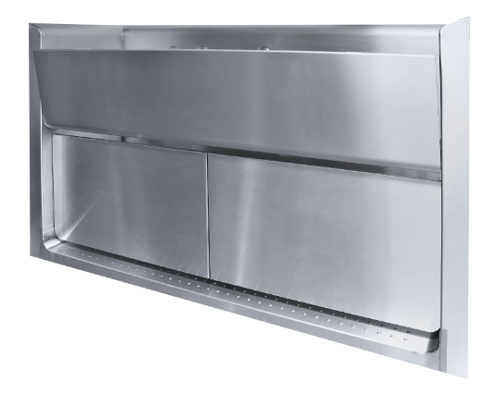
foldable bench as pool-cover niche
☑️
☑️
☑️
easy and revisable even under water (2 locking screws)
metal covers without visible screws (except in combination with air bubble bench)
metal covers can be easily removed when the seat is
folded up

Slide 15
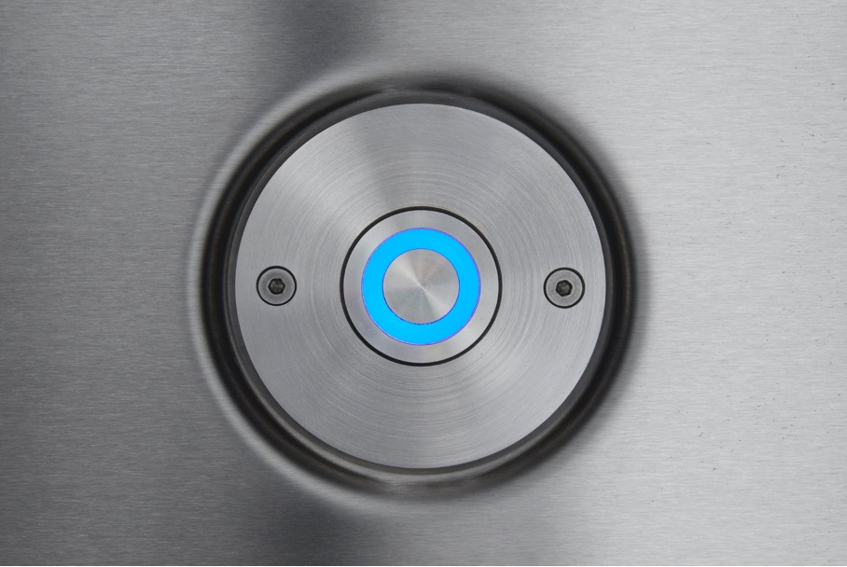
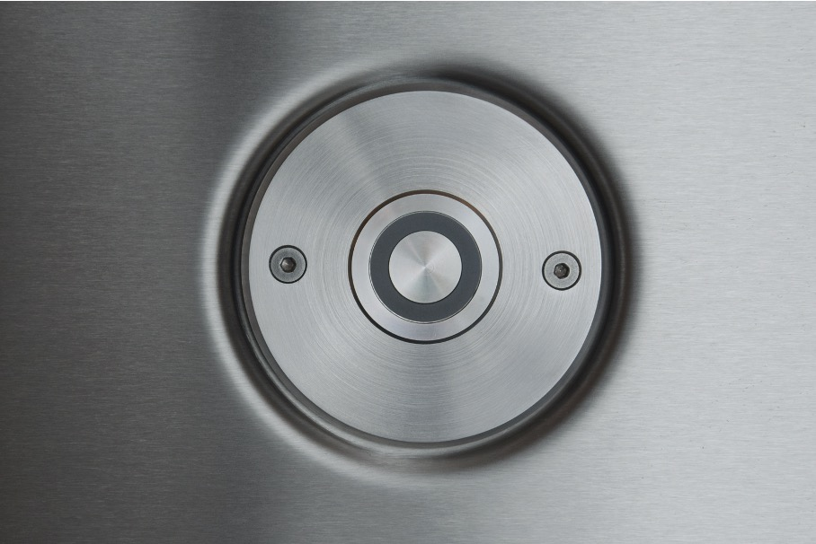
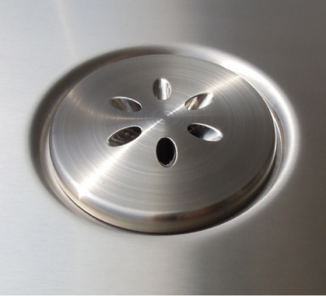
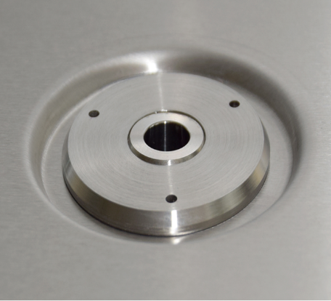
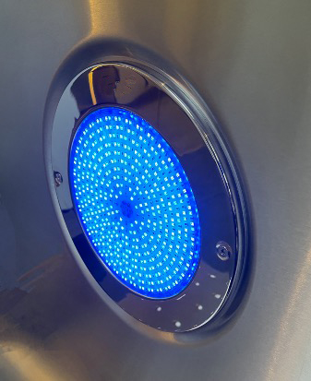
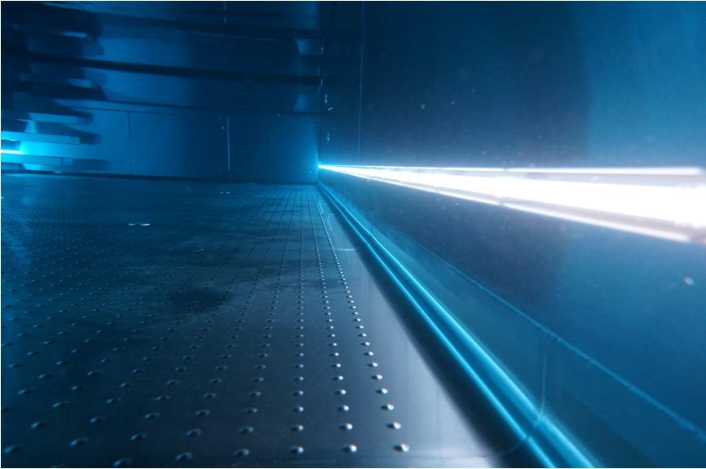
wall mounted parts
☑️
☑️
sunk placed
shapely

Slide 16
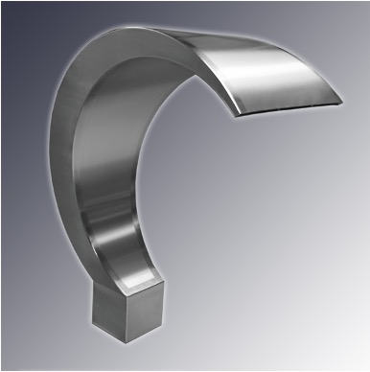
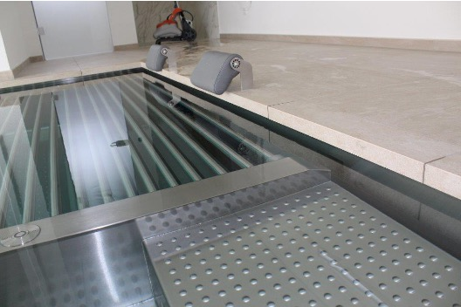
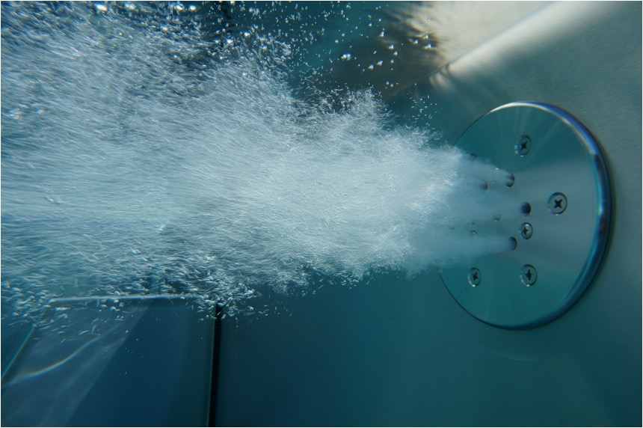
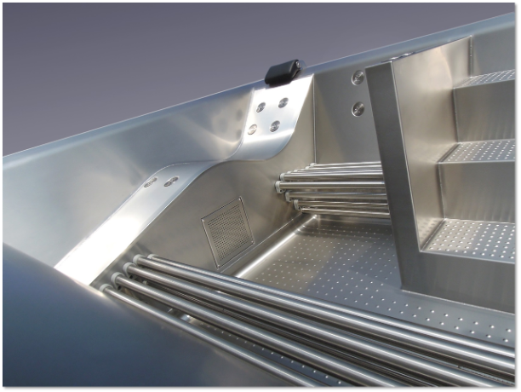
attractions
☑️
☑️
☑️
customized
with air and water
for a feel well oasis

Slide 17
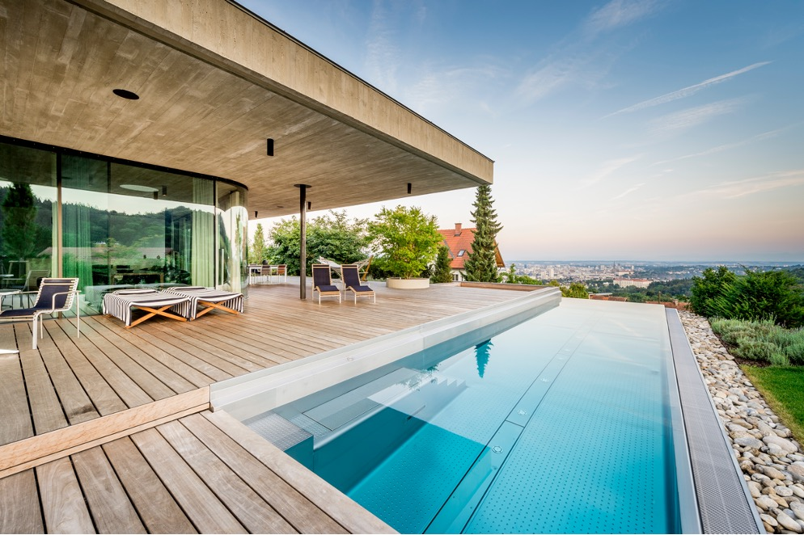
SEE THE
DIFFERENCE?
Martin Pröll

Slide 18
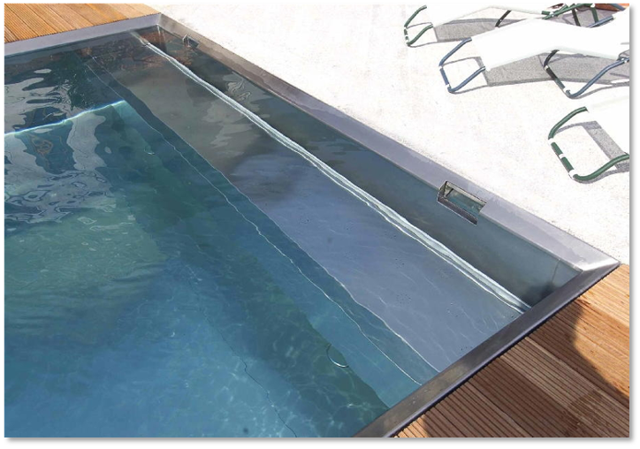

others
☑️
☑️
☑️
☑️
very high water level (skimmer pool)
skimmer basket removable to the water side
no inspection opening outside the pool
different edge designs also for skimmer pools
❌
❌
❌
very low water level due to built-in skimmers
inspection opening outside the pool
pool head only with 90° edging for skimmer basins

Slide 19


others
☑️
☑️
☑️
side walls almost without visible welding points through thoughtful assembly technology
sidewall and floor elements are glued with XPS insulation panels (max. flatness).
insulated walls & floor with 60mm XPS (standard)
no radius between floor and wall
inside welding spots visible as light spots
❌
❌

Slide 20


others
❌
❌
❌
❌
❌
use of prefabricated burled metal sheets
no pre-brushed material
partially cut burls
no regular distances between burls and wall
sloppy welding

Slide 21







INNOVATION
State-of-the-art technology and continuous development with a highly motivated, solution-oriented team finds the optimal solution in the implementation even in difficult conditions

Slide 22



POOL SYSTEM
Benefit from years of experience in the interaction of
stainless steel pools & swimming pool technology
for private as well as commercial facilities

Slide 23





POOLCOVER
As a full-range supplier, pool covers are of course also part of our portfolio.
Whether you need a floating cover,
an enclosures or a winter cover - we have the solution.

Slide 24

COVREX by Rehau
foamed profiles,
no hollows and endcaps
weather resistant, therefore year-round usable
(-20° to +70° C)
very high hail resistance
suitable for unusual pool shapes
excellent insulation properties
☑️
☑️
☑️
☑️
☑️
a foamed PVC profile
tongue and groove as well as connection made of PUR
(firmly connected by extrusion process)
sophisticated design
outstanding material properties
incomparably easy to clean
closed, easy to clean surface
high storm & child safety in connection with patented PROTECTION SYSTEM
individual cutting of the profiles during installation on site
savings of pool chemicals and heating costs of up to 80%

Slide 25



protection system
☑
☑
☑
☑
☑
☑
two plastic half-shells form fit screwed in the profile
same colors like profiles
“COVREX by Rehau’’
straps including ground anchor
profiles swim rigidly on the water
high child and storm safety
patent registered
Unique child safety in connection with patented PROTECTION SYSTEM
and integrated handrail inside the tub

Slide 26

hollow profiles out of PVC and PC
The hollow profiles out of PVC or polycarbonate (PC) are distinguished irrespective of the material from the sophisticated design.
The production of each individual slat is done in extrusion process.
Each slat with dimensions of 60 x 14 mm
has three hollow chambers and is provided with a double hook system, which locks from slat to slat, resulting in a solid pool cover.

Slide 27

PVC hollow profiles
☑
☑
☑
☑
cost-effective alternative to
”Covrex by Rehau’’ or hollow profiles out of PC
proven system for decades
possible colors: solar, transparent, white, gray, ivory, light blue, dark blue
special colors on request

Slide 28

PC hollow
profiles
☑️
☑️
☑️
☑️
extraordinary impact-proof
temperature resistant up to 120°C
largely hail resistent to particle size of 30 mm
Possible colors: solar, transparent, light blue-transparent, dark blue-transparent, green-transparent, silver-transparent, silver/solar

Slide 29



references hollow profiles

Slide 30

safety handrails
Maximum safety for pool covers through the installation of integrated handrails.
This means that the cover profiles can only dive down until the level of the handrails.
The load capacity depends on the choosen profile.

Slide 31




pool enclosures

Slide 32


TRANSPORTATION
in one piece
skimmer pools up to a max. internal width
of 3.4 m
fast assembly
on site
(1-2 working days)
☑️
☑️

Slide 33



TRANSPORTation in parts
extremely high degree of pre-fabrication (unscored at
the market)
tailored to the situation on site
☑️
☑️

Slide 34

public references
Spas, sports facilities, hospitals, therapy centers, hotels, chalets and residential complexes.
We are your reliable partner

Slide 35

Spa Mondorf
Mondorf-Les-Bains (Luxemburg)

Slide 36



Hotel Cortisen
St. Wolfgang am Wolfgangsee (Austria)

Slide 37


Hotel Tirol
Ischgl (Austria)

Slide 38


Hotel Almhof
Nauders (Austria)
realized together with Fankhauser Installationen

Slide 39

Hotel Schwarzer Adler
Kitzbühel (Austria)

Slide 40


FC Bayern Munich
Munich (Germany)
realized together with Seufert & Fink

Slide 41

FC Bayern Campus
Munich (Germany)
realized together with Pool & Wellness Ettl

Slide 42



Hotel Enichlmayr
Ohlsdorf (Austria)

Slide 43


Hotel Winzer
Kogl (Austria)

Slide 44


The Grand - Apartements
Kitzbühel (Austria)
realized together with Hagleitner Installationen

Slide 45

Hotel Lorünser
Zürs am Arlberg (Austria)

Slide 46


Hacienda Resort
Santo Domingo (Dominican Republic)

Slide 47


Elements
Munich (Germany)
realized together with RE-HE Schwimmbäder

Slide 48


Hotel Breisach
Breisach (Germany)
realized together with Herzog Schwimmbäder

Slide 49


Hotel Ritzenhof
Saalfelden (Austria)

Slide 50


Hotel Ultima
Gstaad (Switzerland)
realized together with LeaderSPA

Slide 51

privat references
You plan your
private oasis for recreation and
fun for the whole family.
skimmer or overflow
We are your reliable partner

Slide 52




House O.
Steyr (Austria)

Slide 53


House S.
Neuhofen an der Krems (Austria)

Slide 54


House H.
Wallern (Austria)
Haas Architektur/Szabados

Slide 55



House I.
Wolfern (Austria)

Slide 56


House K.
Lichtenberg (Austria)

Slide 57

House P.
Geneva (Switzerland)
realized together with LeaderSPA

Slide 58


House H.
Schwertberg (Austria)

Slide 59



Show garden
Ermensee (Switzerland)
realized for Vita Bad AG

Slide 60




Penthouse S.
Vienna (Austria)

Slide 61


Villa K.
Malaga (Spain)
realized together with Pool Aesthetics

Slide 62


House H.
Tiefenfucha (Austria)

Slide 63



Villa Ö.
Enns (Austria)

Slide 64


Villa T.
Saragossa (Spain)
realized together with Pool Aesthetics

Slide 65


House E.
Linz (Austria)
Martin Pröll
Martin Pröll

Slide 66



House B.
Wiener Neustadt (Austria)

Slide 67


House H.
Vienna (Austria)

Slide 68


Villa L.
Eppan (Italy)
realized together with Pro Wellness

Slide 69


House F.
Nöchling (Austria)

Slide 70



House G.
Sierning (Upper Austria)

Slide 71






DIGITAL
Follow us online

Slide 72
edelstahl-pool.at

